Slide 1
Slides to promote NSSE 2025
Use for digital displays, posters, newsletters, etc. especially in March, aimed at seniors and first years
Messaging on these slides aligns w/NSSE guidelines
Please review and follow the promotion guidelines found on nsse.wsu.edu
Feel free to chose among the images provided or to swap in a photo from your campus or context
Contact Bill Davis with questions: (wbdavis@wsu.edu)

Slide 2


The National Survey of Student Engagement (NSSE) collects important information about your student experience so WSU can improve the education of all students.
Starting March 3, take the survey using the link in myWSU or in your WSU email.
Respond by April 19 and you’ll be entered in a campus drawing to win a $100 Visa gift card!
See nsse.wsu.edu for odds of winning
Thank you!
Seniors & Freshmen
we need to hear from you
  Your activities inside and outside class
  What you’ve gained from your classes
  Your experience with mental health and wellness

Slide 3
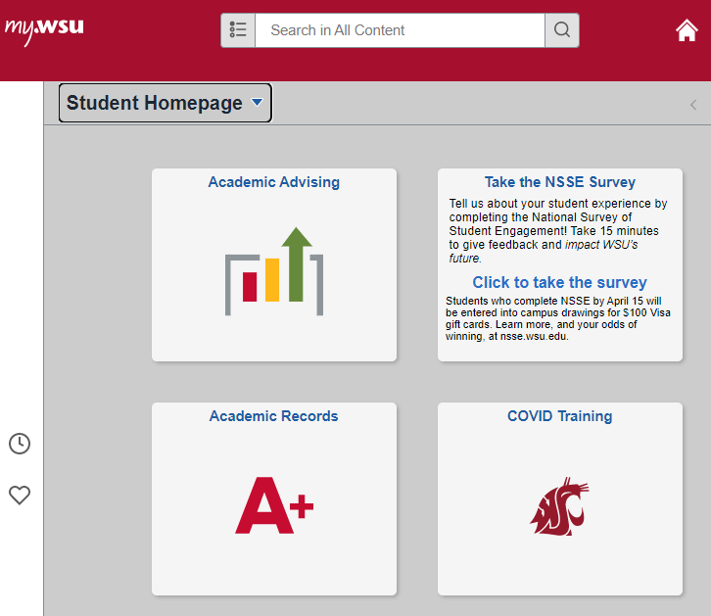
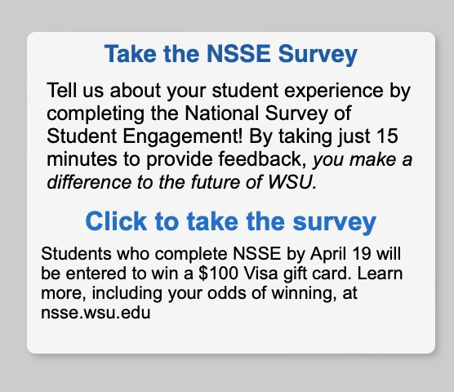
The National Survey of Student Engagement (NSSE) collects important information about your student experience so WSU can improve the education of all students.
Starting March 3, take the survey using the link in myWSU or in your WSU email.
Respond by April 19 and you’ll be entered in a campus drawing to win a $100 Visa gift card!
See nsse.wsu.edu for odds of winning
Thank you!
Survey Access in myWSU
1. Log in
2. Select the NSSE Tile

Slide 4
The National Survey of Student Engagement (NSSE) collects important information about your student experience so WSU can improve the education of all students.
Starting March 3, take the survey using the link in myWSU or in your WSU email.
Respond by April 19 and you’ll be entered in a campus drawing to win a $100 Visa gift card!
See nsse.wsu.edu for odds of winning
Thank you!
Survey Access in myWSU
1. Log in
2. Select the NSSE Tile

Slide 5

The National Survey of Student Engagement (NSSE) collects important information about your student experience so WSU can improve the education of all students.
Starting March 3, take the survey using the link in myWSU or in your WSU email.
Respond by April 19 and you’ll be entered in a campus drawing to win a $100 Visa gift card!
See nsse.wsu.edu for odds of winning
Thank you!
Seniors & Freshmen
we need to hear from you
  Your activities inside and
outside class
  What you’ve gained from
your classes
  Your experience with mental
health and wellness

Slide 6

The National Survey of Student Engagement (NSSE) collects important information about your student experience so WSU can improve the education of all students.
Starting March 3, take the survey using the link in myWSU or in your WSU email.
Respond by April 19 and you’ll be entered in a campus drawing to win a $100 Visa gift card!
See nsse.wsu.edu for odds of winning
Thank you!
Seniors & Freshmen
we need to hear from you
  Your activities inside and outside class
  What you’ve gained from your classes
  Your experience with mental health and wellness

Slide 7

The National Survey of Student Engagement (NSSE) collects important information about your student experience so WSU can improve the education of all students.
Starting March 3, take the survey using the link in myWSU or in your WSU email.
Respond by April 19 and you’ll be entered in a campus drawing to win a $100 Visa gift card!
See nsse.wsu.edu for odds of winning
Thank you!
Seniors & Freshmen
we need to hear from you
  Your activities inside and
outside class
  What you’ve gained from
your classes
  Your experience with mental
health and wellness

Slide 8
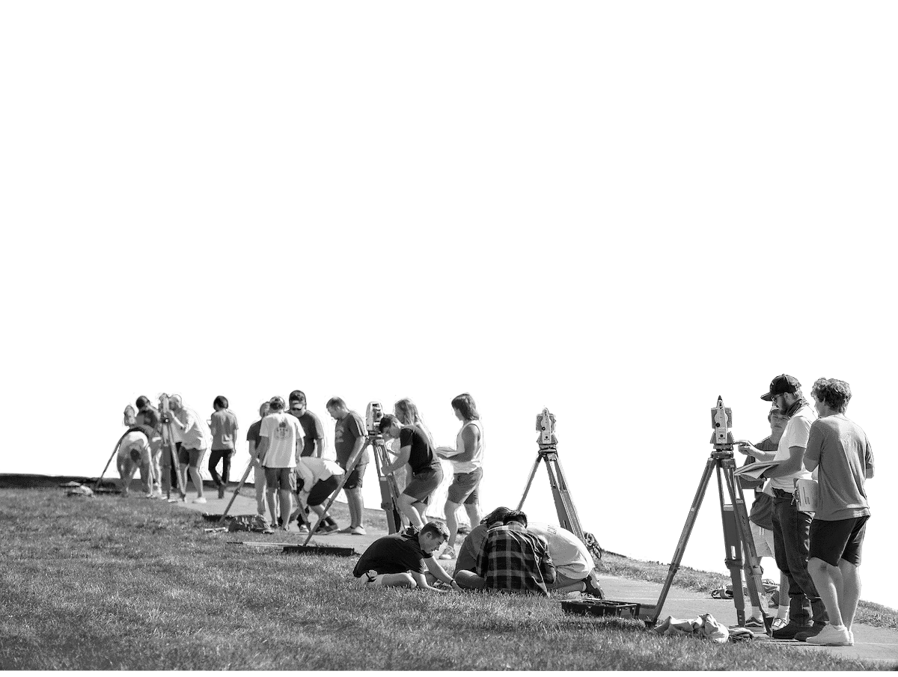
The National Survey of Student Engagement (NSSE) collects important information about your student experience so WSU can improve the education of all students.
Starting March 3, take the survey using the link in myWSU or in your WSU email.
Respond by April 19 and you’ll be entered in a campus drawing to win a $100 Visa gift card!
See nsse.wsu.edu for odds of winning
Thank you!
Seniors & Freshmen
we need to hear from you
  Your activities inside and outside class
  What you’ve gained from your classes
  Your experience with mental health and wellness

Slide 9
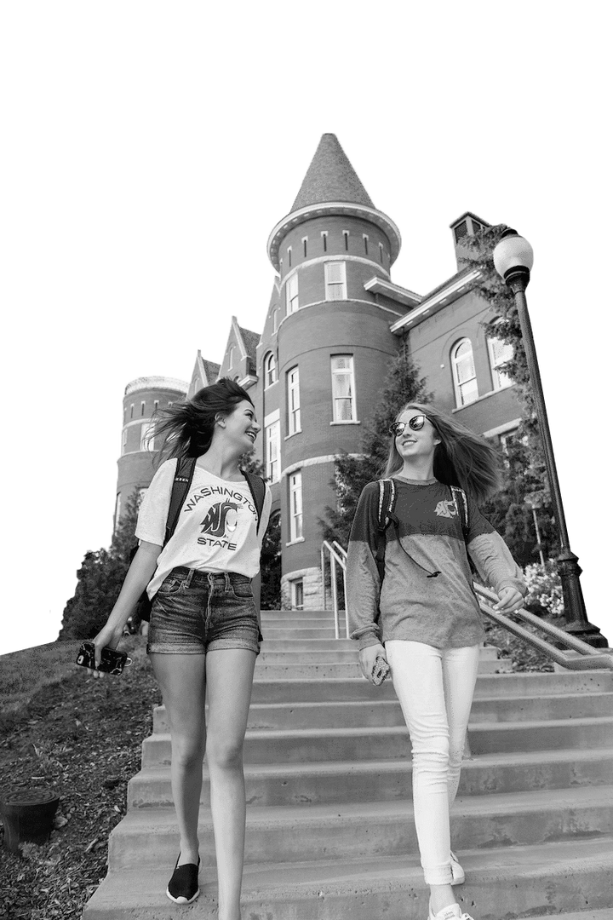
The National Survey of Student Engagement (NSSE) collects important information about your student experience so WSU can improve the education of all students.
Starting March 3, take the survey using the link in myWSU or in your WSU email.
Respond by April 19 and you’ll be entered in a campus drawing to win a $100 Visa gift card!
See nsse.wsu.edu for odds of winning
Thank you!
Seniors & Freshmen
we need to hear from you
  Your activities inside and
outside class
  What you’ve gained from
your classes
  Your experience with mental
health and wellness

Slide 10
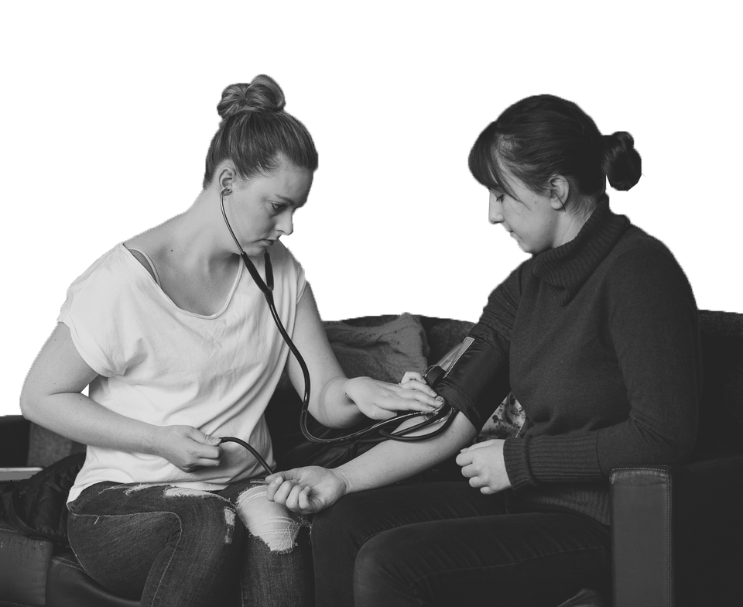
The National Survey of Student Engagement (NSSE) collects important information about your student experience so WSU can improve the education of all students.
Starting March 3, take the survey using the link in myWSU or in your WSU email.
Respond by April 19 and you’ll be entered in a campus drawing to win a $100 Visa gift card!
See nsse.wsu.edu for odds of winning
Thank you!
Seniors & Freshmen
we need to hear from you
  Your activities inside and outside class
  What you’ve gained from your classes
  Your experience with mental health and wellness

Slide 11

The National Survey of Student Engagement (NSSE) collects important information about your student experience so WSU can improve the education of all students.
Starting March 3, take the survey using the link in myWSU or in your WSU email.
Respond by April 19 and you’ll be entered in a campus drawing to win a $100 Visa gift card!
See nsse.wsu.edu for odds of winning
Thank you!
Seniors & Freshmen
we need to hear from you
  Your activities inside and
outside class
  What you’ve gained from
your classes
  Your experience with mental
health and wellness

