Slide 1
Slides to promote NSSE 2023 *Use for digital displays, posters, newsletters, etc. especially in March, aimed at seniors and first years *Messaging on these slides aligns w/NSSE guidelines *Please review and follow the promotion guidelines found on nsse.wsu.edu *Feel free to chose among the images provided or to swap in a photo from your campus or context *Contact Kimberly Green with questions (kimberly_green@wsu.edu)

Slide 2
Seniors and first-year students, tell us your story through the NSSE survey.
The National Survey of Student Engagement (NSSE) collects important information about your student experience.
Starting March 1, take the survey using the link in myWSU or in your WSU email.
Respond by April 15 and you’ll be entered in a campus drawing to win a $100 VISA gift card.
(See nsse.wsu.edu for odds of winning on your campus)
Thank you!
→ Your activities inside and outside class → What you’ve gained from your classes → Seniors: Your post-graduation plans

Slide 3
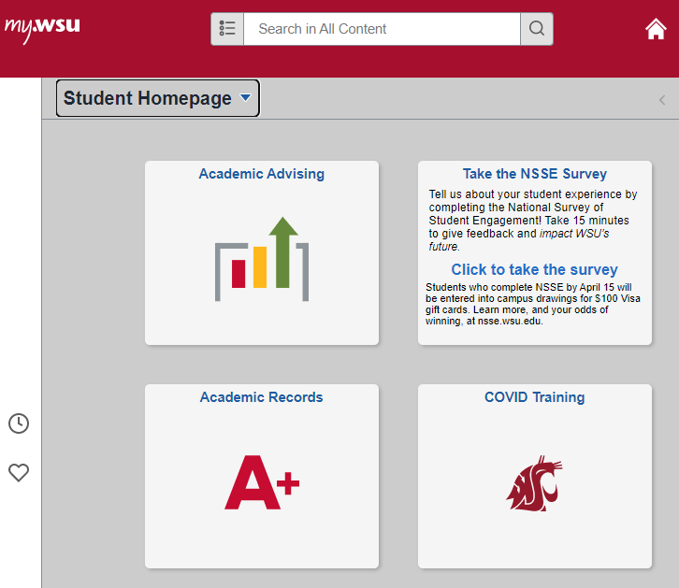
Survey access in myWSU 1. Log in 2. Click on the NSSE tile
The National Survey of Student Engagement (NSSE) collects important information about your student experience.
Starting March 1, take the survey using the link in myWSU or in your WSU email.
Respond by April 15 and you’ll be entered in a campus drawing to win a $100 VISA gift card.
(See nsse.wsu.edu for odds of winning on your campus)
Thank you!

Slide 4
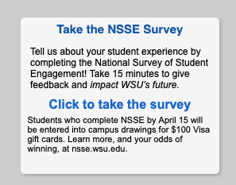
Survey access in myWSU 1. Log in 2. Click on the NSSE tile
The National Survey of Student Engagement (NSSE) collects important information about your student experience.
Starting March 1, take the survey using the link in myWSU or in your WSU email.
Respond by April 15 and you’ll be entered in a campus drawing to win a $100 VISA gift card.
(See nsse.wsu.edu for odds of winning on your campus)
Thank you!

Slide 5
Seniors and first-year students, tell us your story through the NSSE survey.
The National Survey of Student Engagement (NSSE) collects important information about your student experience.
Starting March 1, take the survey using the link in myWSU or in your WSU email.
Respond by April 15 and you’ll be entered in a campus drawing to win a $100 VISA gift card.
(See nsse.wsu.edu for odds of winning on your campus)
Thank you!
→ Your activities inside and outside class → What you’ve gained from your classes → Seniors: Your post-graduation plans

Slide 6
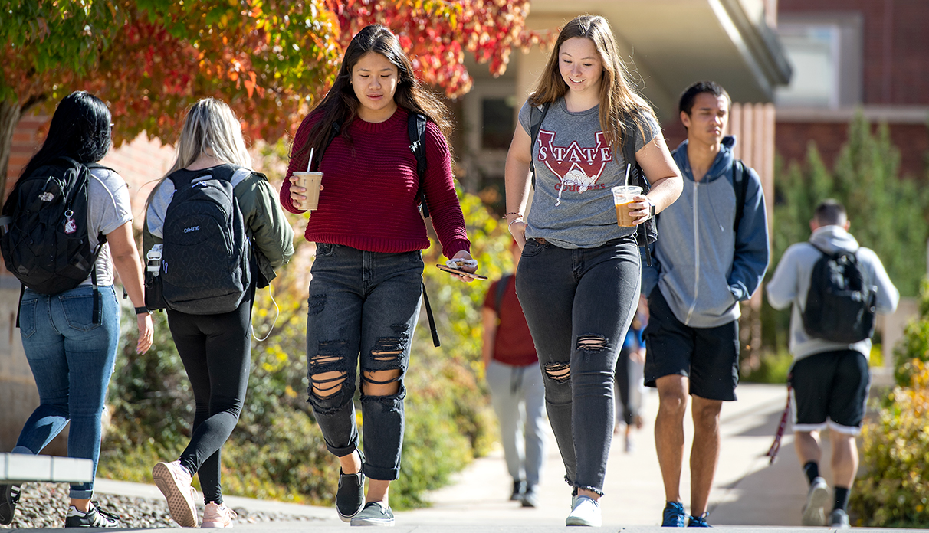
Seniors and first-year students, tell us your story through the NSSE survey.
The National Survey of Student Engagement (NSSE) collects important information about your student experience.
Starting March 1, take the survey using the link in myWSU or in your WSU email.
Respond by April 15 and you’ll be entered in a campus drawing to win a $100 VISA gift card.
(See nsse.wsu.edu for odds of winning on your campus)
Thank you!
→ Your activities inside and outside class → What you’ve gained from your classes → Seniors: Your post-graduation plans

Slide 7
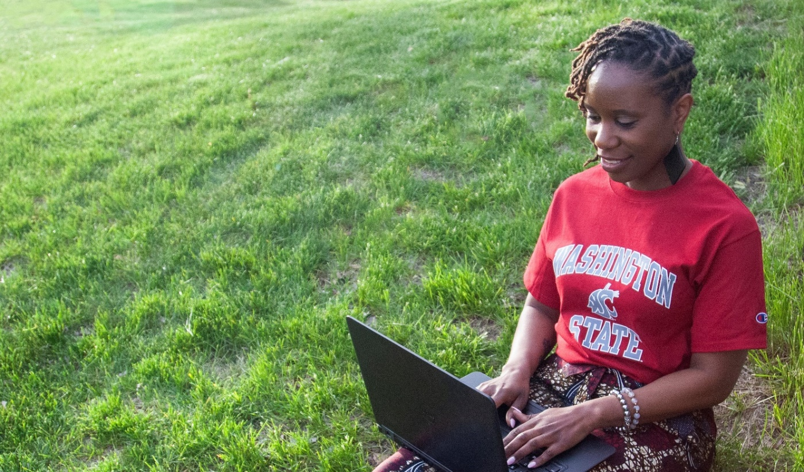
Seniors and first-year students, tell us your story through the NSSE survey.
The National Survey of Student Engagement (NSSE) collects important information about your student experience.
Starting March 1, take the survey using the link in myWSU or in your WSU email.
Respond by April 15 and you’ll be entered in a campus drawing to win a $100 VISA gift card.
(See nsse.wsu.edu for odds of winning on your campus)
Thank you!
→ Your activities inside and outside class → What you’ve gained from your classes → Seniors: Your post-graduation plans

Slide 8
Seniors and first-year students, tell us your story through the NSSE survey.
The National Survey of Student Engagement (NSSE) collects important information about your student experience.
Starting March 1, take the survey using the link in myWSU or in your WSU email.
Respond by April 15 and you’ll be entered in a campus drawing to win a $100 VISA gift card.
(See nsse.wsu.edu for odds of winning on your campus)
Thank you!
→ Your activities inside and outside class → What you’ve gained from your classes → Seniors: Your post-graduation plans

Slide 9
Seniors and first-year students, tell us your story through the NSSE survey.
The National Survey of Student Engagement (NSSE) collects important information about your student experience.
Starting March 1, take the survey using the link in myWSU or in your WSU email.
Respond by April 15 and you’ll be entered in a campus drawing to win a $100 VISA gift card.
(See nsse.wsu.edu for odds of winning on your campus)
Thank you!
→ Your activities inside and outside class → What you’ve gained from your classes → Seniors: Your post-graduation plans

Slide 10
Seniors and first-year students, tell us about your educational experience through the NSSE survey.
The National Survey of Student Engagement (NSSE) collects important information about your student experience.
Starting March 1, take the survey using the link in myWSU or in your WSU email.
Respond by April 15 and you’ll be entered in a campus drawing to win a $100 VISA gift card.
(See nsse.wsu.edu for odds of winning on your campus)
Thank you!
→ Give feedback to help impact WSU’s future!

Slide 11
Seniors and first-year students, tell us your story through the NSSE survey.
The National Survey of Student Engagement (NSSE) collects important information about your student experience.
Starting March 1, take the survey using the link in myWSU or in your WSU email.
Respond by April 15 and you’ll be entered in a campus drawing to win a $100 VISA gift card.
Thank you!
(Based on campus participation in 2021, your odds of winning are approximately: Pullman, 10 winners (1 in 180); Vancouver, 2 winners (1 in 148); Tri-Cities, 1 winner (1 in 132); Global Campus, 2 winners (1 in 81); Spokane, 2 winners (1 in 44); Everett, 1 winner (1 in 37).
→ Your activities inside and outside class → What you’ve gained from your classes → Seniors: Your post-graduation plans

