Slide 1
Seniors and first-year students, tell us your story through the NSSE survey.
The National Survey of Student Engagement (NSSE) collects important information about your student experience.
Starting March 1, take the survey using the link in myWSU or in your WSU email.
Respond by April 15 and you’ll be entered in a campus drawing to win a $100 VISA gift card.
(See nsse.wsu.edu for odds of winning)
Thank you!
→ Your activities inside and outside class → What you’ve gained from your classes → Seniors: Your post-graduation plans

Slide 2
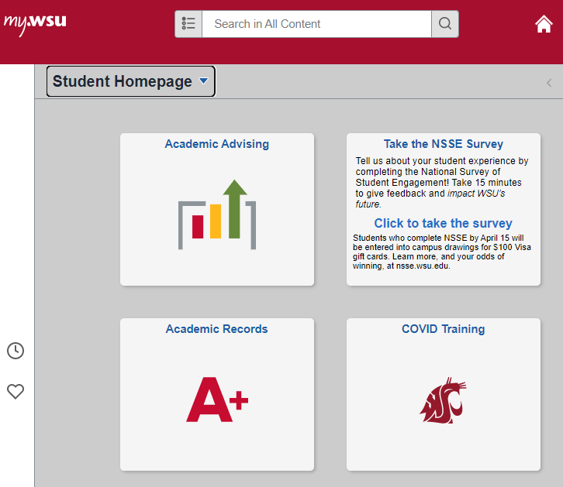
Survey access in myWSU 1. Log in 2. Click on the NSSE tile
The National Survey of Student Engagement (NSSE) collects important information about your student experience.
Starting March 1, take the survey using the link in myWSU or in your WSU email.
Respond by April 15 and you’ll be entered in a campus drawing to win a $100 VISA gift card.
(See nsse.wsu.edu for odds of winning)
Thank you!

Slide 3
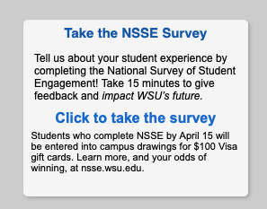
Survey access in myWSU 1. Log in 2. Click on the NSSE tile
The National Survey of Student Engagement (NSSE) collects important information about your student experience.
Starting March 1, take the survey using the link in myWSU or in your WSU email.
Respond by April 15 and you’ll be entered in a campus drawing to win a $100 VISA gift card.
(See nsse.wsu.edu for odds of winning)
Thank you!

